Slide 1
Adaptive Crowdsourcing via EM with Prior
Peter Maginnis
Tanmay Gupta

Slide 2
Main Contributions
Derivation of EM with transformed beta prior
Adaptive graph construction
Random Forest Ranking
Features:
Task entropy
Histogram of worker abilities
Number of workers per task

Slide 3
Expectation-Maximization
Tasks
Workers

Slide 4
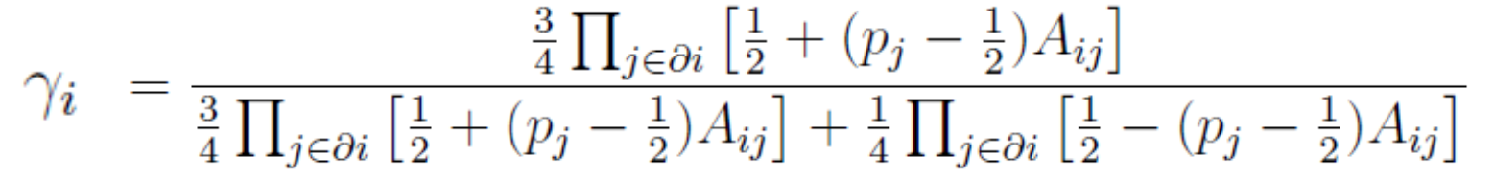
EM without beta prior
E Step:

Slide 5
EM without beta prior
M Step:

Slide 6
EM with Beta Prior:
M Step:

Slide 7


EM with Beta Prior:
Quadratic with 2 root
One root below 0.1
One root between 0.1 and 1

Slide 8
Initial Graph
Current Graph
EM
Add edges
Predict mislabeled tasks
Graph Adaptivity at a Glance

Slide 9
Initial Graph
Current Graph
EM
Generate Random Data
Prior
Graph Update
EM
Rank Tasks
Learn RF

Slide 10
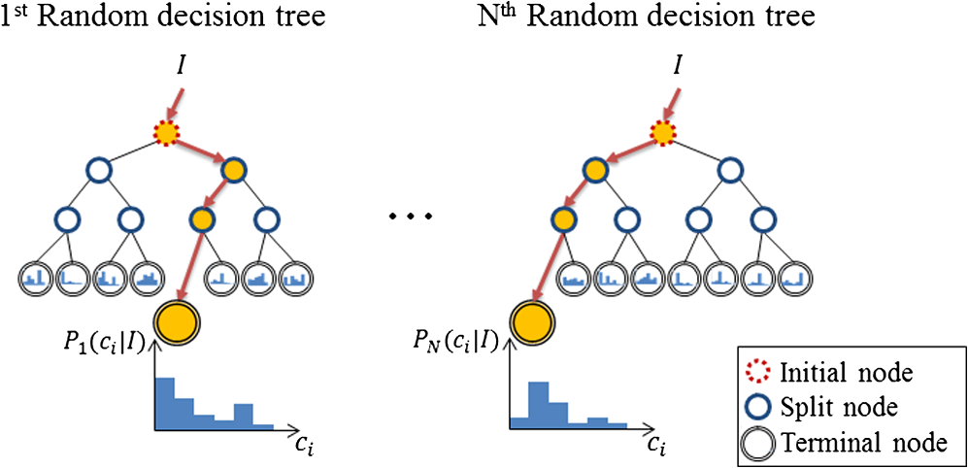
Image: Choi, Junyeong, et al. "iHand: an interactive bare-hand-based augmented reality interface on commercial mobile phones." Optical Engineering 52.2 (2013): 027206-027206.

Slide 11
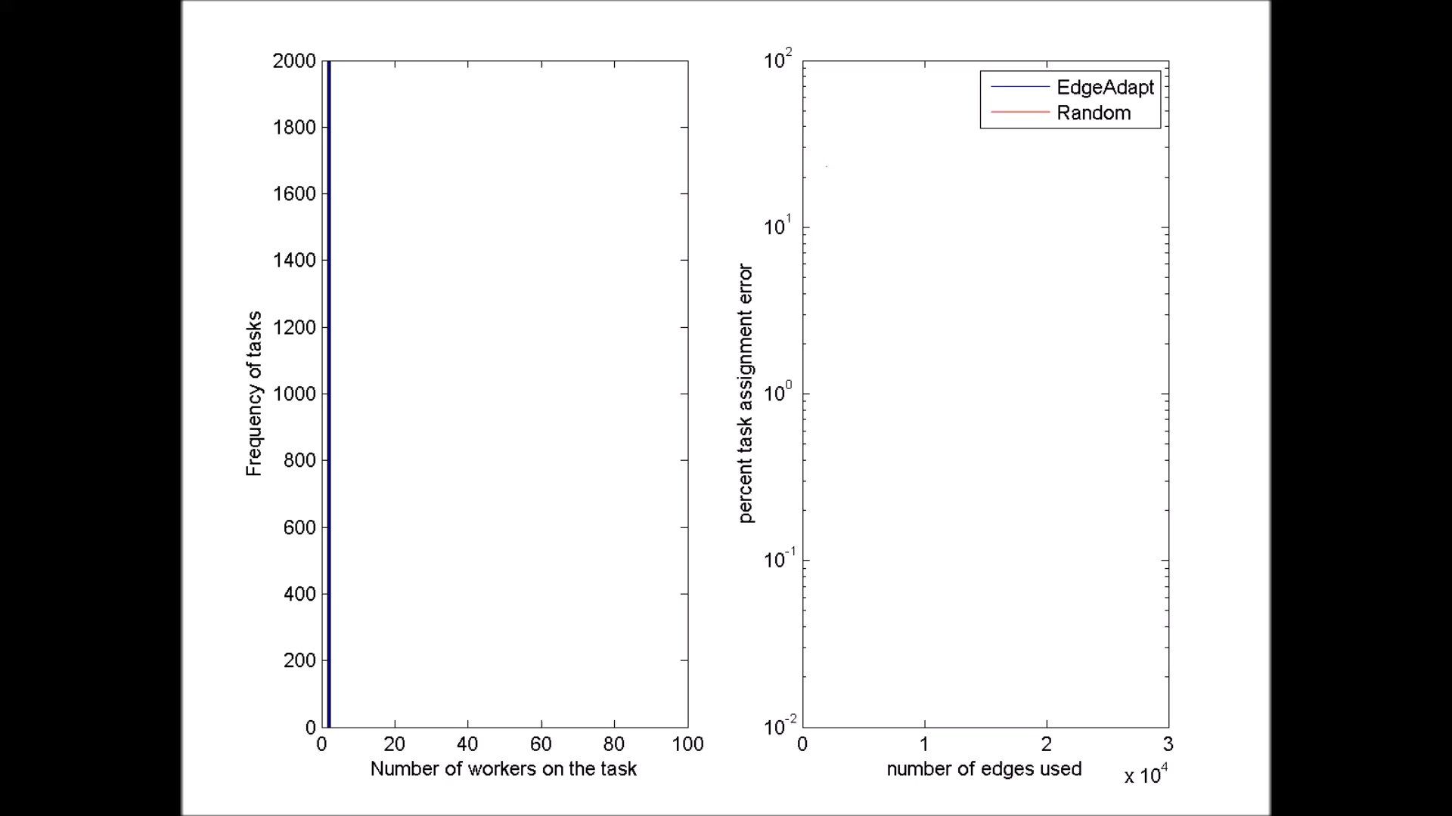
Adaptive Graph Construction

Slide 12
Quantitative Results: 100 Workers

Slide 13
Quantitative Results: 30 Workers

